Slide 1
European Media in the Digital Context: analysis and approaches update 2016
Richard Rooke, Professor, HWR Berlin School of Economics and Law
Fellow of the Royal Society of Arts, London

Slide 2
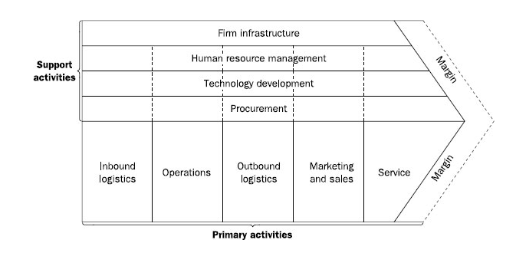
Book update 2009-2016: analysis and approaches
EU context
Data
Economics
Regulations
Theory
Michael Porter – from production to consumption – the question of ‘values’ and the ‘value chain’.
Comparative work in different contexts (international, national, regional, public-private)
Sectoral differences- TV, film, radio, print, audio-visual, etc.

Slide 3
EU context: regulation and markets – public and private – the digital agenda 2016.

Slide 4
The Digital Economy and Society Index (DESI) is a composite index that summarises relevant indicators on Europe’s digital performance and tracks the evolution of EU Member States in digital competitiveness.
Denmark, Sweden, the Netherlands and Belgium have the most advanced digital economies in the EU followed by Belgium, the UK and Estonia.
Romania, Bulgaria, Greece and Italy are at the bottom of the list.
The five dimensions of the DESI
1 Connectivity | Fixed Broadband, Mobile Broadband, Broadband speed, and Affordability
2 Human Capital | Basic Skills and Usage, Advanced skills and Development
3 Use of Internet | Content, Communication and Transactions on line
4 Integration of Digital Technology | Business digitization and eCommerce (40%)
5 Digital Public Services | eGovernment and eHealth (33%)

Slide 5
Next Generation Access: the cities are mostly covered
Total NGA coverage has now reached 68% in, a gain of 6 points in the last year and of 39 points over the last five years. At the end of 2014, Cable Docsis 3.0 had the largest NGA coverage at 43%, followed by VDSL (38%) and FTTP (19%). Most of the upgrades in European cable networks already took place by 2011, while VDSL coverage doubled in the last three years. There was a remarkable progress also in FTTP growing from 10% in 2011 to 19% in 2014.
NGA networks are currently very much limited to urban areas: rural coverage is only 25%, coming mainly from VDSL.

Slide 6
Internet use: a success story
Regular Internet use in the EU has increased by 14 percentage points since the launch of the Digital Agenda, from just above 60% to just below 75%, reaching the target. Even in the last year the score went up by 3 percentage points, indicating that there is still quite some distance to go before approaching saturation levels.
Progress has been largest in countries with a low starting level, contributing to improved cohesion in the EU, but for any given starting level there are significant variations in outcome, as digital inclusion policies have been more or less active. The biggest gains of above 20 points occurred in Greece, Cyprus, Croatia and the Czech Republic.
Conversely, the share of the population which has never used the Internet has declined by 12 points to reach 18%, and might achieve the target of 15% next year.
Progress has been especially strong for disadvantaged groups, among which regular Internet use has now reached 60%, up from 41% five years ago. Here, too, the target has been reached. The biggest increase can be observed in the UK, where the share of disadvantaged online has gone up by 25 percentage points in the last three years alone.
Frequent Internet usage, i.e. connecting at least daily, has risen by 17% (as opposed to 15% at least weekly for regular Internet usage), indicating a trend among regular users to more frequent use.
Source: Eurostat

Slide 7
Media in the digital context: from print to audio-visual - 2016

Slide 8
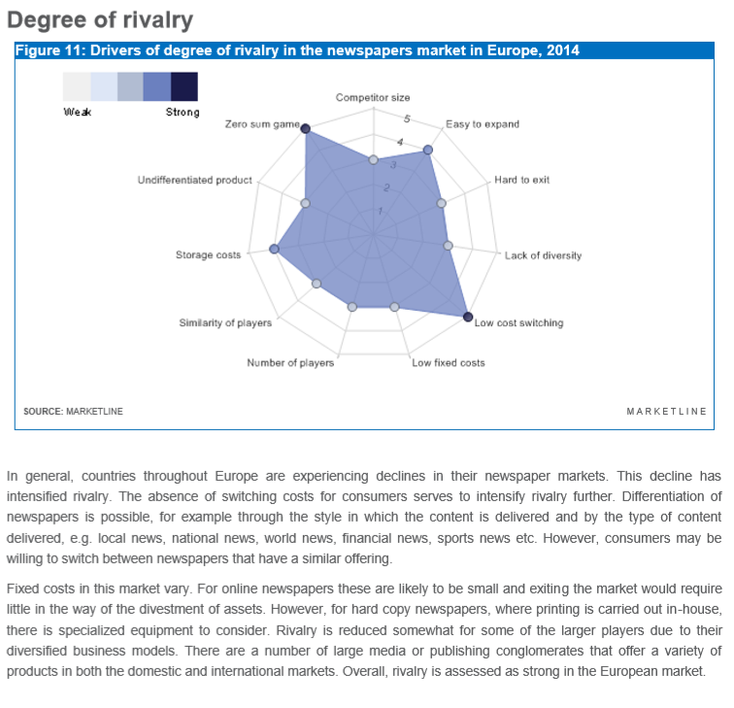
MarketLine pub.2015 - newspapers

Slide 9
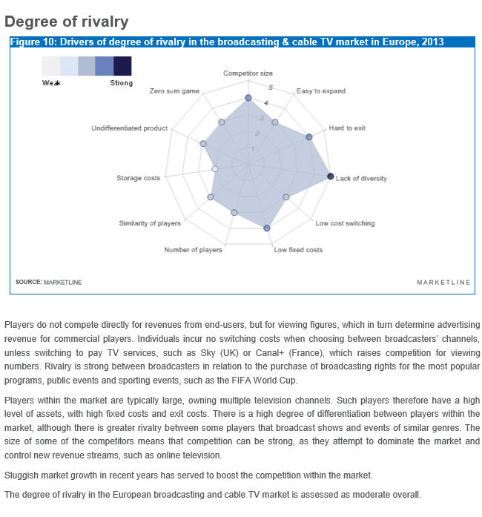
MarketLine: Broadcasting and TV pub.2014

Slide 10
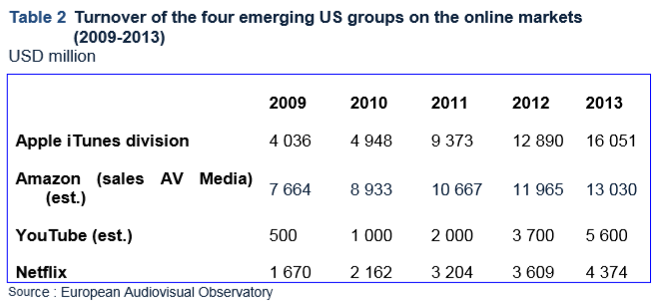
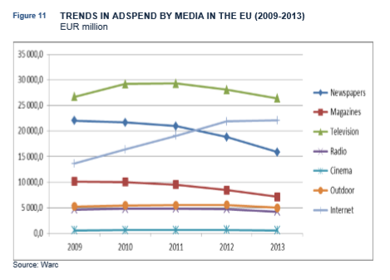
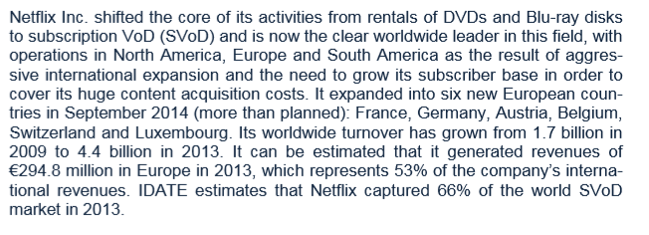
Case study: “Netflix” EAO et al 2015

Slide 11
Futures? Issues…
From Production to Consumption: getting the power balance right – public and private.
Global media: trans-national corporations especially digital telecommunication companies with support specialist content providers (e.g. Netflix).
Financial models are re-adjusting (being disrupted) – public and private.
Sectors and states: print, radio, television, Audio-Visual, and film: fragmentation and increased (skills) specialisms increasing plus trans-national convergence but national characteristics remain.
Journalism: from local news to mega-data – fears and opportunities.
Social Media: communication and networks – the impact of the internet (e.g. Facebook, Amazon, etc.).
Ethics – moral and data protection (privacy) - major issues for organisations and journalists. (The work of OSCE exemplary).

Slide 12
Sources for presentation – an ‘update’:
A. Lange et al, (2015), “The development of the European market for on-demand audio-visual services.” EAO, Council of Europe.
MarketLine (2014) “Broadcasting & Cable TV in Europe.”
MarketLine (2015) “Newspapers in Europe.”
S. Saroka et al, (2015) “ It’s (Change in) the (future) Economy, Stupid: Economic indicators, the Media, and Public Opinion, American Journal of Political Science, Vol 59, No 2April 2015, pp 457-474
G. Allen et al, (2014) “The rise and fall of Netflix: what happened and where will it go from here? Journal of International Academy of Case Studies, Vol 20, Number 2, 2014
European Commission (2015) DESI“ Use of internet”, “Digital Targets Agenda”, “e-Commerce”, “eGovernment”.
European Commission (2016) “EU-U.S. Privacy Shield”
M. David (Ed) et al (2016) “Sixty five years of European Governance” (Caviedes, Maas), Journal of Contemporary Research, Vol 12 Issue 1 , 2016, pp 394- 590
IRIS: Legal Observations of the European Audiovisual Observatory (IRIS 2016-2) “Newsletter”

Slide 13
Thank you for listening and for having me here in Belgrade!

